Slide 1
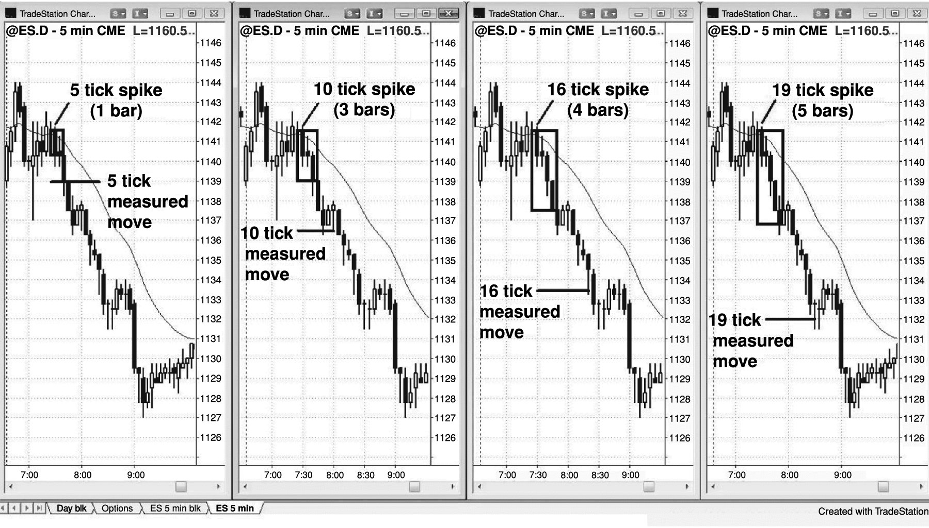
FIGURE 25.1 As a Spike Grows, So Does the Profit Target

Slide 2
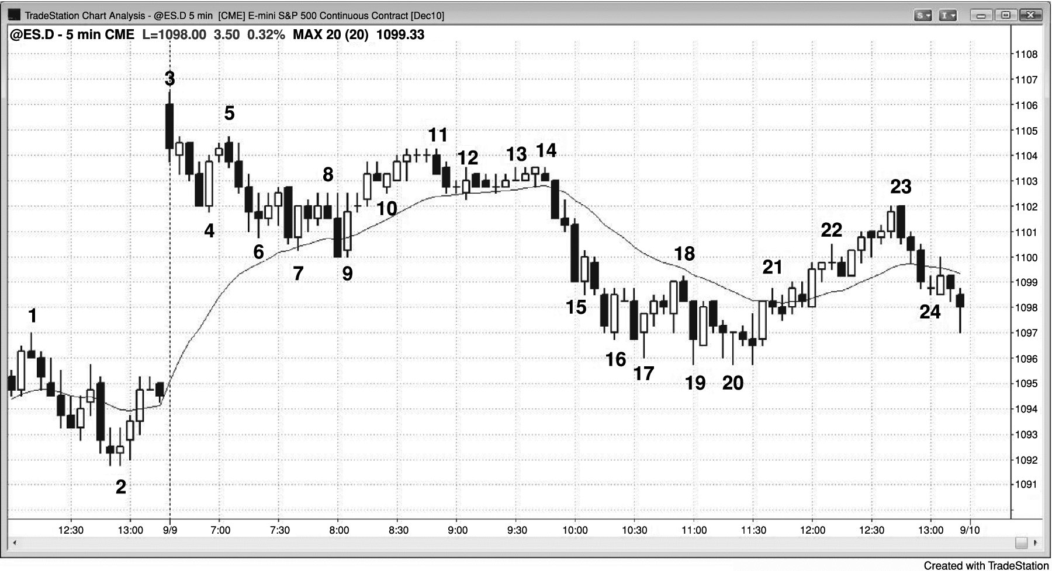
FIGURE 25.2 Look for Brief Moments of Higher Probability

Slide 3
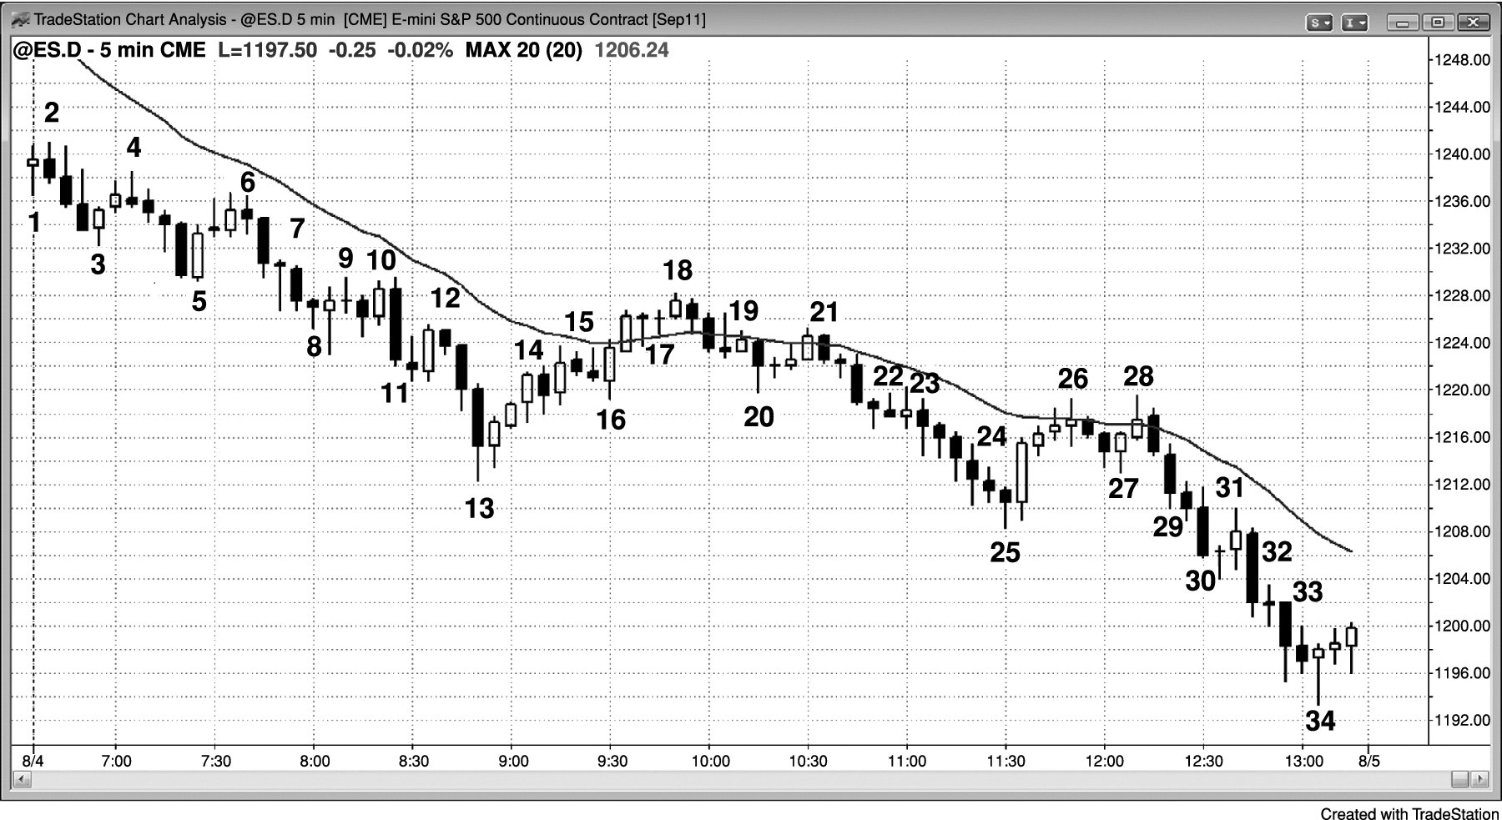
FIGURE 25.3 Scalpers Often Miss Trends When the Setups Are Not High Probability

